Slide 1

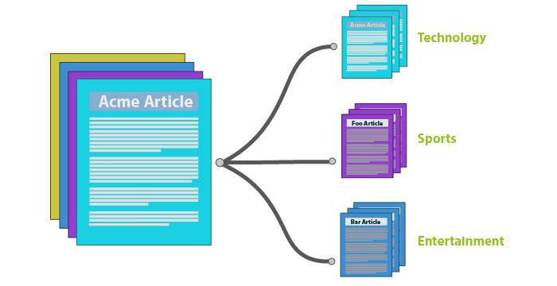

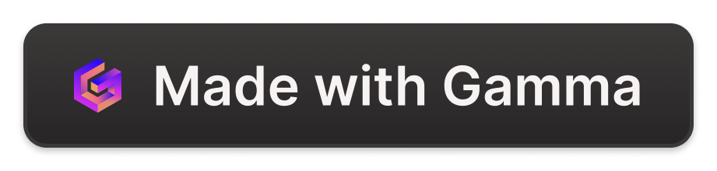
Introduction to Text Classification in NLP
Text classification is a fundamental task in natural language processing (NLP) that involves assigning predefined categories or labels to text data. This technique is widely used in various applications, from spam detection to sentiment analysis and topic modeling.
by Regina SABS

Slide 2
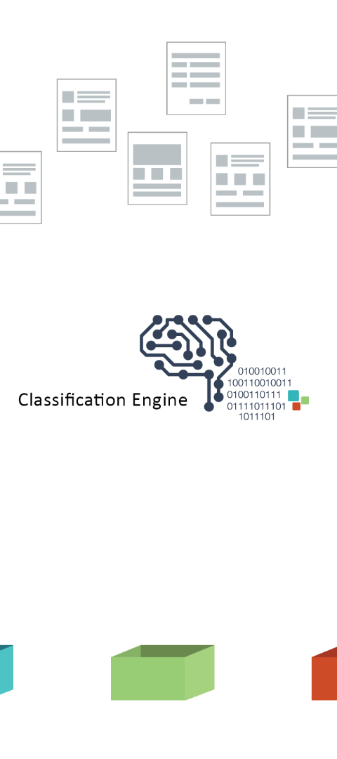
Importance of Text Classification
Organizing Large Text Datasets
Improved Decision-Making
Text classification helps categorize and structure vast amounts of textual data, enabling efficient information retrieval and analysis.
By automatically identifying the topic, sentiment, or intent behind text, organizations can make more informed, data-driven decisions.
Personalized User Experiences
Text classification powers features like email filtering, targeted ads, and content recommendations, enhancing user engagement and satisfaction.

Slide 3
Use Cases and Applications
Sentiment Analysis
Spam Detection
Classify text as positive, negative or neutral to understand customer opinions, reviews, and social media sentiment.
Identify and filter out spam emails, comments, or messages to keep online interactions clean and productive.
Topic Modeling
Automated Tagging
Categorize documents, articles, or web pages into relevant topics to enable efficient content organization and search.
Automatically assign relevant tags or labels to text-based content to aid in retrieval and discoverability.

Slide 4

Feature Extraction Techniques
Bag-of-Words
TF-IDF

Slide 5
Bag of Words (BoW) Technique
Definition
Bag of Words (BoW) is a simple and widely used text representation technique in Natural Language Processing (NLP). It treats each document as an unordered collection of words, disregarding grammar and word order.
Applications
BoW is commonly used for text classification, topic modeling, sentiment analysis, and other NLP tasks where the focus is on the presence and frequency of words rather than their relationships.
1
2
3
Feature Extraction
BoW creates a vocabulary from all unique words in the corpus and represents each document as a vector of word counts. This vector captures the frequency of each word in the document.

Slide 6



Feature Extraction with BoW
Tokenization
1
Break text into individual words
Vocabulary Creation
2
Create a list of unique words
Vector Representation
3
Convert text to numerical vector
The Bag of Words (BoW) technique for feature extraction involves three key steps. First, the text is tokenized into individual words. Then, a vocabulary is created by compiling a list of all unique words. Finally, the text is converted into a numerical vector representation, where each element corresponds to the count or presence of a word from the vocabulary.

Slide 7
Bag-of-Words Implementation
Steps
Libraries
Limitations
Preprocess text (tokenization, stopword removal, stemming/lemmatization)
Popular libraries for Bag-of-Words include scikit-learn, NLTK, and spaCy in Python, and CountVectorizer in R.
Bag-of-Words ignores word order and relationships, and may struggle with polysemy and synonymy.
Create a vocabulary of unique words
Encode each document as a vector of word frequencies

Slide 8
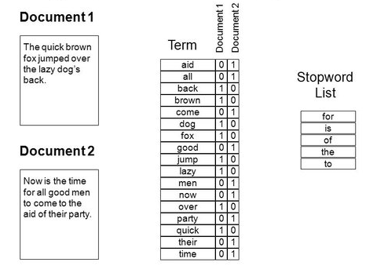
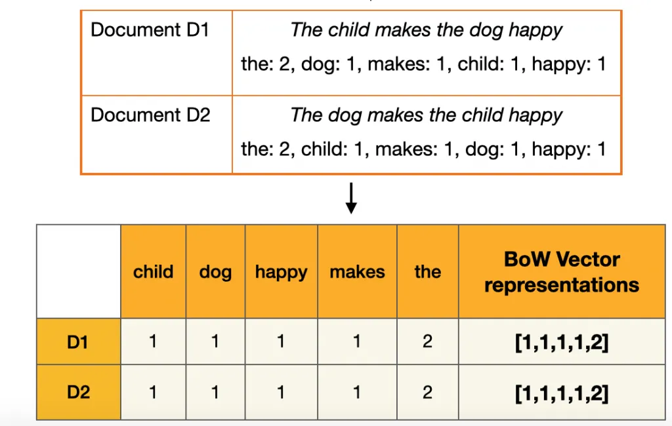
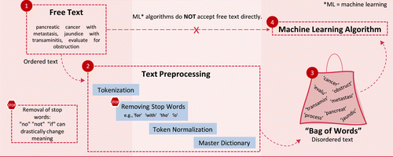
Bag-of-Words
Examples

Slide 9

Bag-of-Words Advantages and Disadvantages
Advantages
Disadvantages
Simple to implement, computationally efficient, and works well for many text-based tasks.
Ignores word order and relationships, may not capture semantic meaning, and can be sensitive to vocabulary differences.

Slide 10
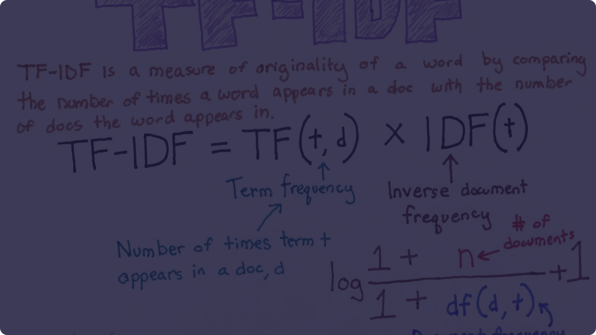



Term Frequency-Inverse Document Frequency (TF-IDF)
Concept
Term Frequency (TF)
Inverse Document Frequency (IDF)
TF-IDF is a statistical method that measures how important a word is to a document in a collection or corpus. It combines term frequency (TF) and inverse document frequency (IDF) to quantify the significance of a word.
TF measures how often a word appears in a document. It's a simple count of the occurrences of a word, giving more weight to words that appear more frequently.
IDF measures how important a word is across the entire corpus. It reduces the weight of words that appear in many documents, as they are less informative for distinguishing between documents.

Slide 11

Term Frequency-Inverse Document Frequency (TF-IDF)
1
Term Frequency (TF)
Measures how often a word appears in a document, capturing its importance within that document.
2
Inverse Document Frequency (IDF)
Downweights words that appear in many documents, as they are less informative for distinguishing documents.
3
TF-IDF Scoring
Combines TF and IDF to produce a numerical score that reflects a word's importance in a document relative to the corpus.

Slide 12
Feature Extraction with TF-IDF
Step 1
1
Compute Term Frequency (TF)
Step 2
2
Compute Inverse Document Frequency (IDF)
Step 3
3
Multiply TF and IDF to get TF-IDF
TF-IDF is a more sophisticated feature extraction technique compared to Bag of Words. It not only considers how frequently a term appears in a document, but also how rare or important that term is across the entire corpus. This helps identify the most informative and discriminative features for text classification tasks.

Slide 13
TF-IDF Implementation
Steps
Libraries
Advantages
Preprocess text (same as Bag-of-Words)
TfidfVectorizer in scikit-learn, TfidfTransformer in NLTK, and tfidf() in R's tidytext package.
Captures semantic importance of words, works well for many text mining tasks, and is less sensitive to vocabulary differences.
Calculate term frequency (TF) for each word in each document
Calculate inverse document frequency (IDF) for each word
Multiply TF and IDF to get the final TF-IDF score

Slide 14
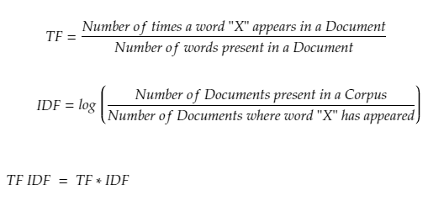
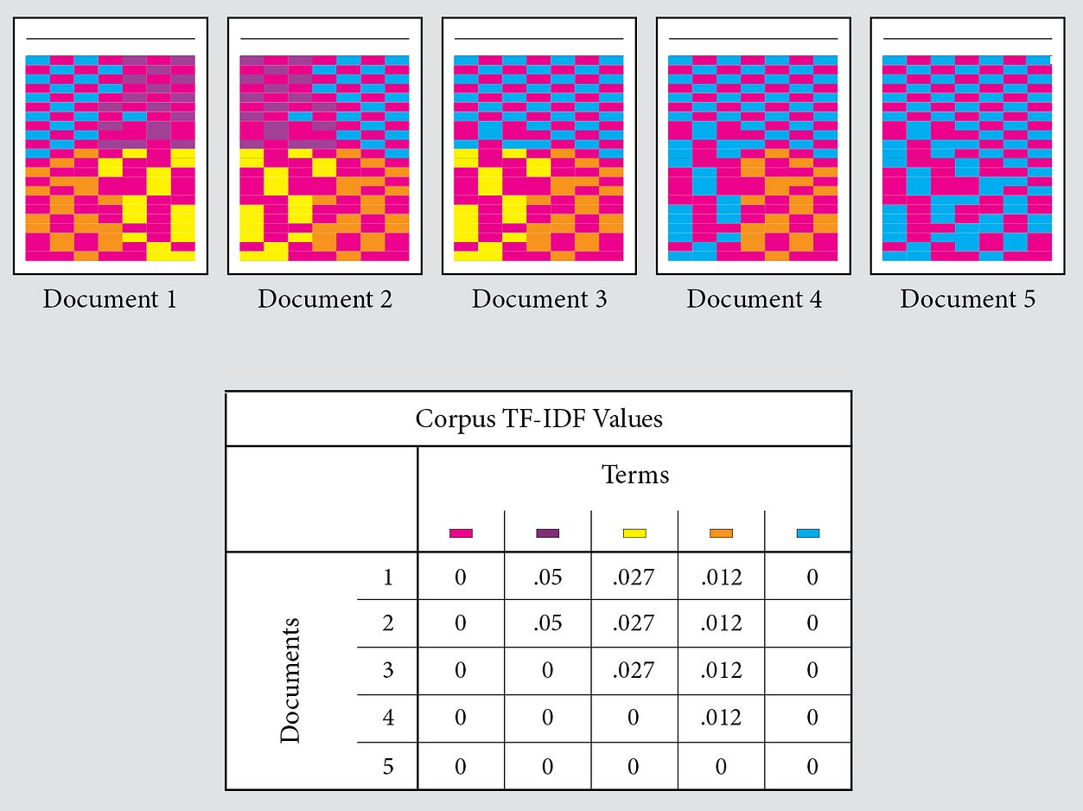
TF-IDF Examples

Slide 15



Advantages and Limitations of BoW and TF-IDF
Advantages
Limitations
Context Sensitivity
BoW and TF-IDF are simple to implement, computationally efficient, and can capture important features in text. They are effective for many text classification tasks.
They do not capture semantic relationships or the order of words. BoW ignores word frequencies while TF-IDF can be sensitive to rare words.
BoW and TF-IDF are context-agnostic, meaning they do not consider the broader context or meaning of words. This can limit their performance on tasks requiring deeper language understanding.

Slide 16
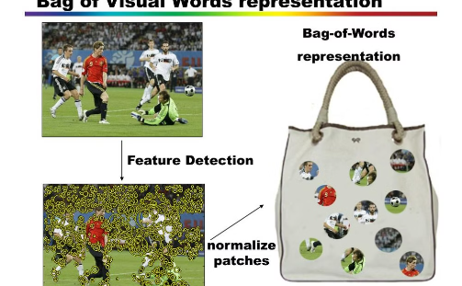
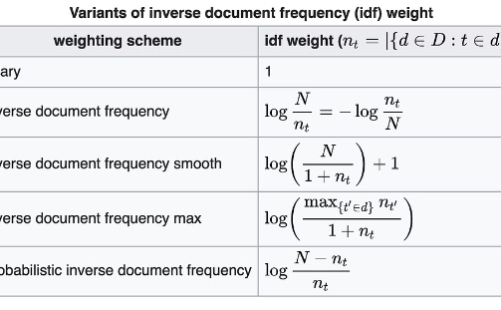
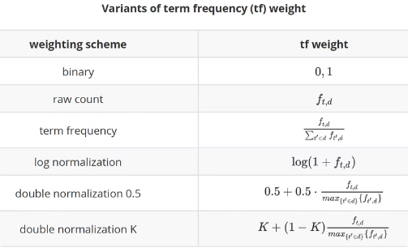
Comparison of BoW and TF-IDF
Bag of Words (BoW)
Term Frequency-Inverse Document Frequency (TF-IDF)
Key Differences
BoW is a simple and efficient method that counts the frequency of each word in a document, ignoring grammar and word order. It captures the essence of a document but loses contextual information.
BoW is easier to implement but TF-IDF generally performs better on text classification tasks by identifying more relevant features. The choice depends on the complexity of the problem and available computational resources.
TF-IDF enhances BoW by weighing each word based on its importance in the document and its rarity in the overall corpus. This captures more semantic meaning and better distinguishes important words.

Slide 17




Sample Activities
Text Processing
Data Visualization
Collaborative Learning
Real-world Application
Implement Bag-of-Words and TF-IDF on a real-world text dataset, and compare their performance on a text classification task.
Visualize and interpret the output of Bag-of-Words and TF-IDF, such as word clouds and document similarity matrices.
Discuss the strengths, weaknesses, and use cases of Bag-of-Words and TF-IDF in a group setting, and share insights.
Apply Bag-of-Words and TF-IDF to a problem in your domain, such as document classification or topic modeling.

Slide 18

Conclusion and Future Trends
In conclusion, text classification in NLP has proven to be a powerful tool for a wide range of applications. As the field continues to evolve, we can expect to see further advancements in feature extraction techniques like BoW and TF-IDF, as well as the emergence of more sophisticated deep learning models.

Slide 19

Sentiment Analysis
Sentiment analysis is a fascinating field within natural language processing (NLP) that focuses on understanding and quantifying emotions, opinions, and attitudes expressed in text. It allows us to automatically determine whether a piece of text conveys a positive, negative, or neutral sentiment.
It is also known as Opinion Mining

Slide 20
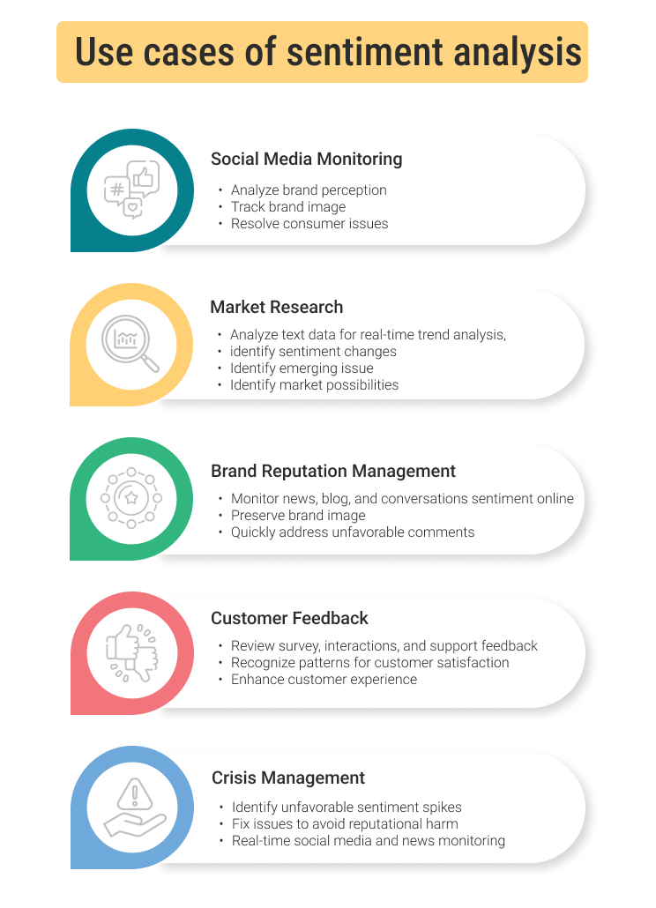
Sentiment Analysis Applications
Analyzing social media posts, reviews, and comments.
Monitoring brand reputation.
Understanding customer feedback.
Market Research
It helps businesses understand the conversations happening around their brand on social media.
It helps businesses track their brand reputation and identify potential issues.
It helps businesses understand customer feedback and improve customer satisfaction.
Sentiment analysis is used to gauge public perception of products and services.

Slide 21
Python Libraries for Sentiment Analysis
Python offers a variety of libraries specifically designed for sentiment analysis, providing pre-trained models and tools for processing text data.
NLTK
TextBlob
Vader Sentiment
A comprehensive toolkit for natural language processing, including sentiment analysis capabilities.
A user-friendly library that simplifies sentiment analysis with built-in functions for polarity and subjectivity.
A lexicon-based approach that specifically focuses on analyzing social media text and identifying emotions.

Slide 22
Understanding Subjectivity in Text
Subjectivity refers to the degree to which a piece of text expresses a personal opinion or belief
rather than objective facts. It helps to distinguish between factual information and opinions and is useful for understanding context and tone.
Subjective
Objective
"This movie was amazing!“
“I believe this theory is flawed”
"The movie was released in 2023.“
“The sun rises in the east”
Subjectivity scores typically range from 0 (objective) to 1 (subjective).

Slide 23

Measuring Polarity: Positive, Negative, and Neutral
Polarity refers to the emotional tone of a piece of text, ranging from positive to negative, with neutral representing no clear emotion. It determines the overall sentiment (positive, negative, neutral), and helps to classify sentiment in reviews, social media posts, etc.
Positive
Neutral
Negative
"This is the best product I've ever used!“
“I love this movie”
"The product is available in multiple colors.“
“The movie is running today also”
"I was very disappointed with this product.“
“This movie is terrible”
Polarity scores typically range from -1 (very negative) to 1 (very positive).

Slide 24

Examples of Sentiment Analysis in Action
Sentiment analysis is widely used in various industries to understand customer opinions, monitor brand reputation, and make informed decisions.
Customer Reviews
Businesses use sentiment analysis to analyze customer reviews and identify areas for improvement.
Social Media Monitoring
Brands track social media conversations to gauge public perception and respond to customer inquiries.
Market Research
Market researchers use sentiment analysis to understand consumer preferences and predict market trends.

Slide 25
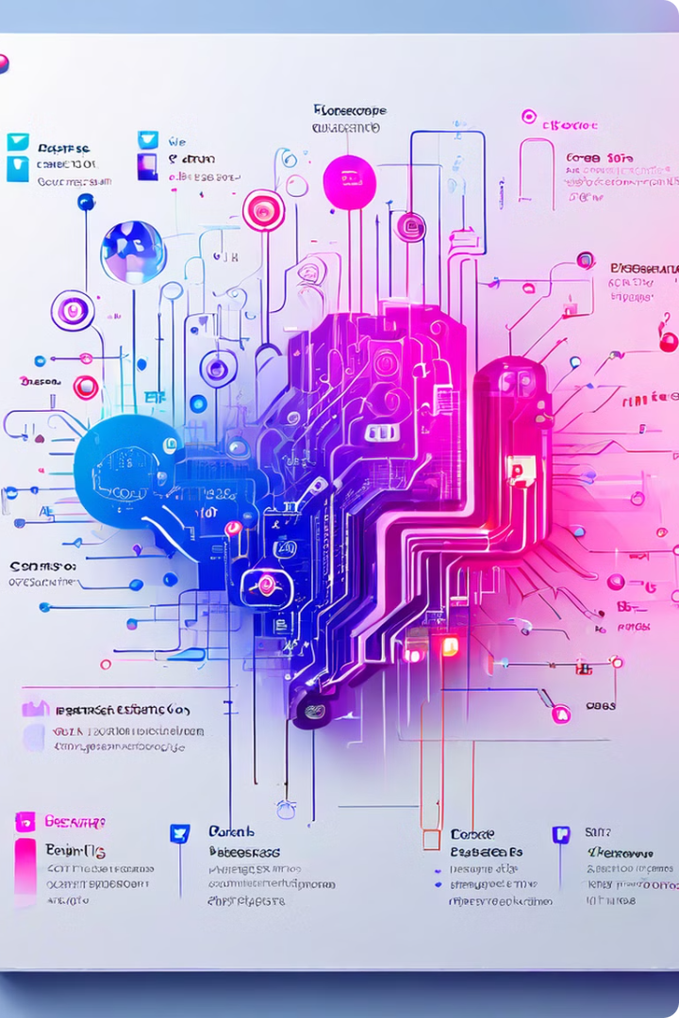



Techniques for Measuring Sentiment
There are various techniques employed for measuring sentiment, ranging from rule-based approaches to advanced machine learning models.
Lexicon-Based
These methods use pre-defined lists of words associated with positive or
negative sentiments.
Machine Learning
These approaches train models on labeled data to classify sentiment
based on patterns in text.
Deep Learning
These models leverage neural networks to capture complex relationships
and nuances in language.

Slide 26
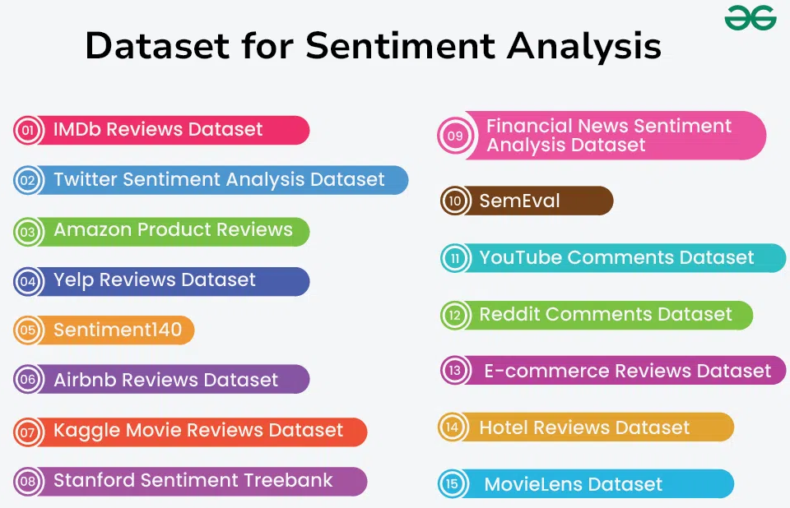
Datasets and Sources for Sentiment Analysis

Slide 27

Understanding the Confusion Matrix
The confusion matrix is a powerful tool in machine learning that provides a comprehensive assessment of a model's performance. It offers insights into the true positive, true negative, false positive, and false negative predictions, enabling developers to deeply understand their model's strengths and weaknesses.

Slide 28

Significance of the Confusion Matrix
1
Model Evaluation
The confusion matrix is essential for evaluating the effectiveness of a machine learning model, allowing for the calculation of key performance metrics.
2
Identify Weaknesses
It helps pinpoint areas where the model is struggling, guiding further optimization and improvement efforts.
3
Informed Decisions
The insights from the confusion matrix empower data scientists to make more informed decisions about model deployment and refinement.

Slide 29
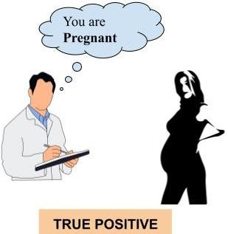
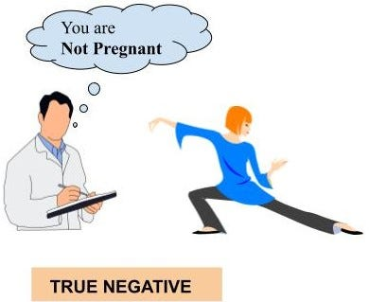
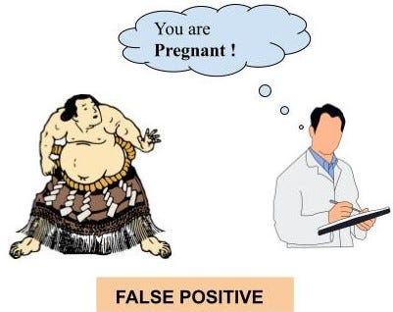
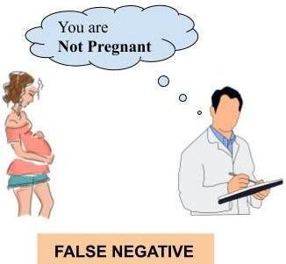
Confusion Matrix Components
True Positive (TP)
True Negative (TN)
False Positive (FP)
False Negative (FN)
Correctly predicted positive instances.
Correctly predicted negative instances.
Incorrectly predicted positive instances.
Incorrectly predicted negative instances.

Slide 30
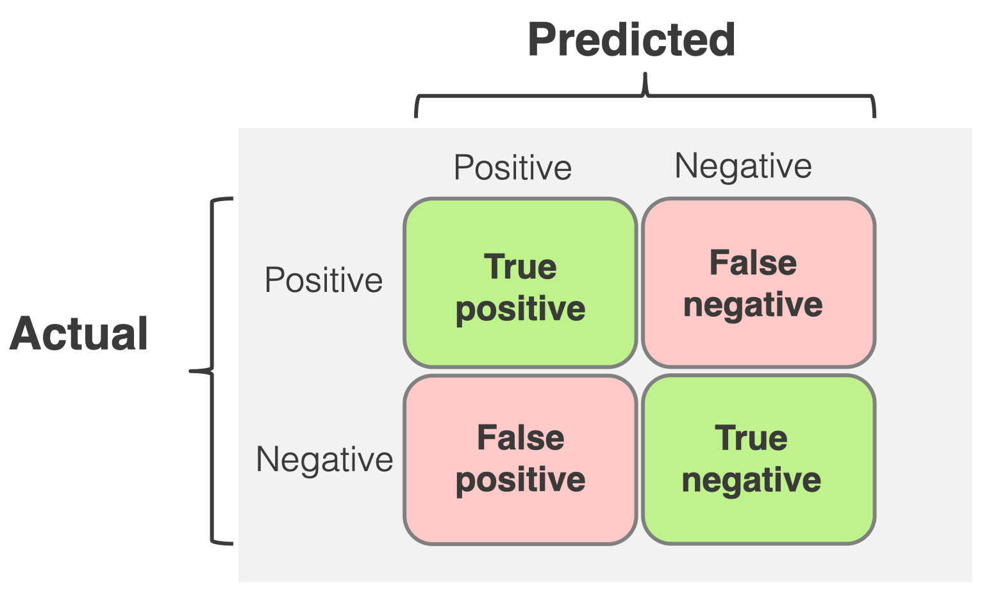
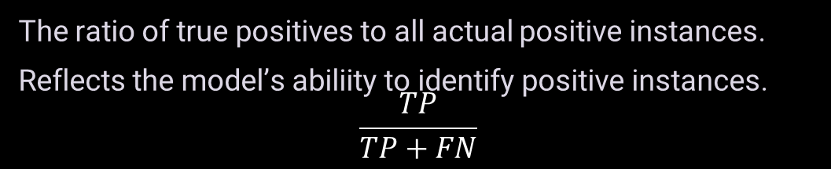
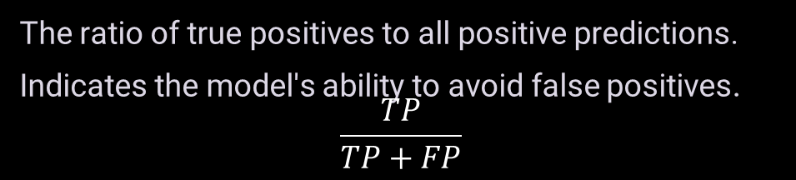
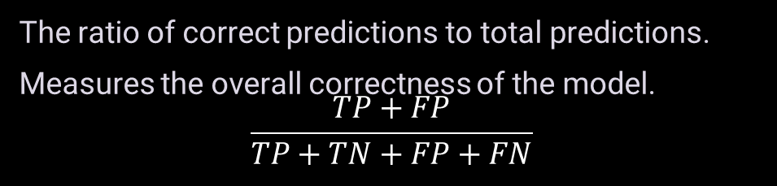
Calculating Performance Metrics
1
Accuracy
The ratio of correct predictions to total predictions.
Measures the overall correctness of the model.
$$\frac{TP+FP}{TP+TN+FP+FN}$$
2
Precision
The ratio of true positives to all positive predictions.
Indicates the model's ability to avoid false positives.
$$\frac{TP}{TP+FP}$$
3
Recall
The ratio of true positives to all actual positive instances.
Reflects the model’s abiliity to identify positive instances.
$$\frac{TP}{TP+FN}$$
4
F-Score
The harmonic mean of precision and recall,
balancing both metrics.

Slide 31





Practical Examples of Confusion Matrix Applications
Healthcare
Analyzing the performance of disease diagnosis models.
Email Spam Detection
Evaluating the accuracy of spam filtering algorithms.
E-commerce
Optimizing product recommendation systems.
Self-Driving Cars
Ensuring the reliability of object detection models.

Slide 32


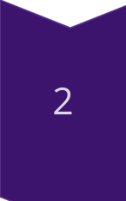
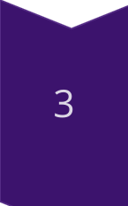
Interpreting Confusion Matrix Results
High TP and TN
Indicates a well-performing model with accurate predictions.
High FP and FN
Suggests the model is struggling and needs further optimization.
Balanced Metrics
A good balance of accuracy, precision, and recall is ideal for most applications.

Slide 33
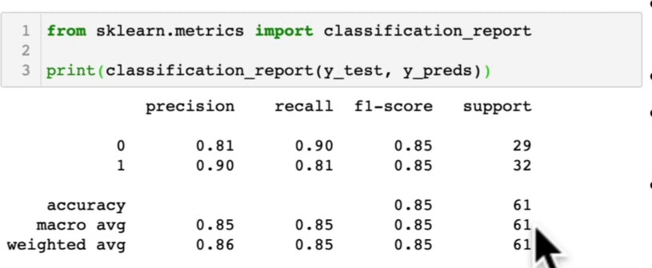
Classification Report
Precision – indicates the proportion of positive identifications which were actually correct. A model that produces no false positives has a precision of 1.0.
Recall – Indicates the proportion of actual positives which were correctly classified. A model which produces no false negatives has a recall of 1.0.
F-Score – A combination of precision and recall. A perfect model achieves a f-score of 1.0.
Support - The number of samples each metric was calculated on.
Accuracy – The accuracy of the model in decimal form. Perfect accuracy is equal to 1.0.
Macro Avg – Short for macro average, the average, precision, recall and F-score between classes. Macro avg doesn’t take class imbalance into account. So, if you have class imbalance pay attention to this metric.
Weighted Avg – Short for weighted average, the weighted average, precision, recall and F-score between classes. Weighted means each metric is calculated with respect to how many samples there are in each class. This metric will favour the majority class.

Slide 34

Importance of the Confusion Matrix
Model Evaluation
The confusion matrix provides a comprehensive assessment of a model's performance, enabling data scientists to make informed decisions.
Optimization
The insights from the confusion matrix guide model refinement and improvement efforts, leading to better-performing systems.
Reliable Deployment
Understanding the strengths and weaknesses of a model through the confusion matrix ensures its appropriate and responsible deployment.

Slide 35
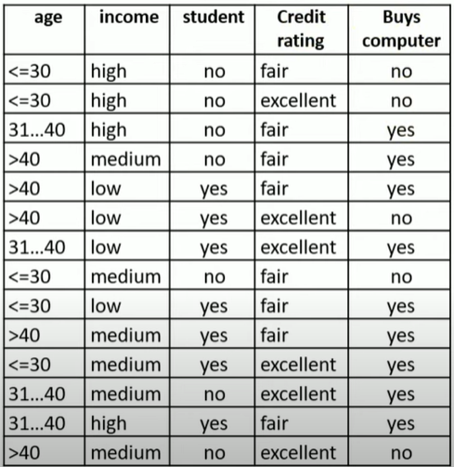
Naïve Bayes Classification
https://www.youtube.com/watch?v=ztYAWF8tzLI
Let X be a data tuple
In Bayesian terms, X is considered “evidence.”
Let H be some hypothesis such as that the data tuple X belongs to a specified class C
For classification problems, we want to determine P(H/X), the probability that the hypothesis H holds given the “evidence” or observed data tuple X.
In other words, we are looking for the probability that tuple X belongs to class C, given that we know the attribute description of X.

Slide 36
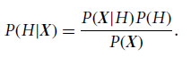
Naïve Bayes Classification
P(H/X) is the posterior probability, or a posteriori probability, of H conditioned on X.
Example: P(H/X) reflects the probability that customer X will buy a computer given that we know the customer’s age and income
P(H) is the prior probability, or a priori probability, of H.
Example: P(H) is the probability that any given customer will buy a computer, regardless of age, income, or any other information
P(X/H) is the posterior probability of X conditioned on H
Example: P(X/H) is the probability that a customer, X, is 35 years old and earns $40,000, given that we know the customer will buy a computer.
P(X) is the prior probability of X
Example: P(X) is the probability that a person from our set of customers is 35 years old and earns $40,000
Bayes’ theorem is

Slide 37
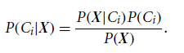
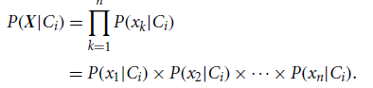
Naïve Bayes Classification
Let D be a training set of tuples and their associated class labels. As usual, each tuple is represented by an n-dimensional attribute vector, X = x1, x2, : : : , xn, depicting n measurements made on the tuple from n attributes, respectively, A1, A2, … , An.
Suppose that there are m classes, C1, C2, … , Cm. Given a tuple, X, the classifier will predict that X belongs to the class having the highest posterior probability, conditioned on X. That is, the naive Bayesian classifier predicts that tuple X belongs to the class Ci if and only if
Thus, we maximize P(Ci/X). The class Ci for which P(Ci/X) is maximized is called the maximum posteriori hypothesis.
By Bayes’ theorem
As P(X) is constant for all classes, only P(X/Ci)*P(Ci) needs to be maximized
Now, P(Ci)=|Ci,D|/|D|, where |Ci,D| is the number of training tuples of class Ci in D
Now,
To predict the class label of X, P(X/Ci)*P(Ci) is evaluated for each class Ci. The classifier predicts that the class label of tuple X is the class Ci if and only if

Slide 38
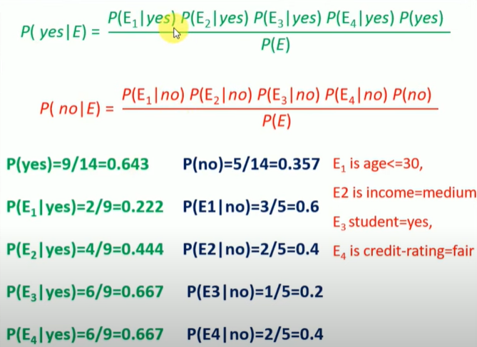
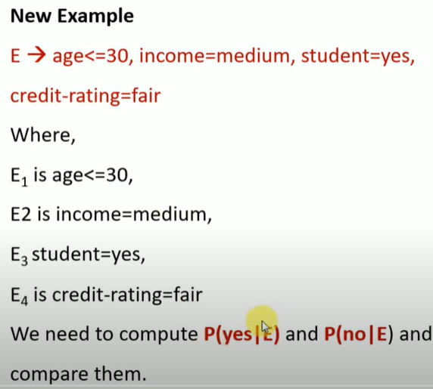
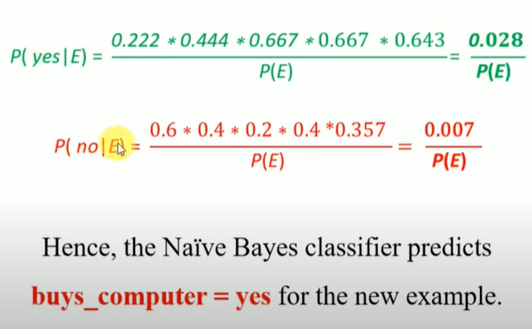
Naïve Bayes Classification

Slide 39
Naïve Bayes - Python Implementation
Import Libraries: Import necessary libraries like pandas for data manipulation and scikit-learn for model building.
import pandas as pd
from sklearn.feature_extraction.text import CountVectorizer
from sklearn.model_selection import train_test_split
from sklearn.naive_bayes import MultinomialNB
from sklearn.metrics import accuracy_score, classification_report, confusion_matrix
Load Data: Load your dataset using pandas
df = pd.DataFrame(data)
Preprocess Data: Perform necessary preprocessing like handling missing values, converting text to lowercase, tokenization, and vectorization.
vectorizer = CountVectorizer()
X = vectorizer.fit_transform(df['text’])
y = df['label']

Slide 40
Naïve Bayes - Python Implementation
Split Data: Split your data into training and testing sets.
X_train, X_test, y_train, y_test = train_test_split(X, y, test_size=0.2, random_state=42)
Train Model: Choose the type of Naive Bayes classifier and train it on the training data.
clf = MultinomialNB()
clf.fit(X_train, y_train)
Evaluate Model: Evaluate the trained model using metrics like accuracy, confusion matrix, and classification report
y_pred = clf.predict(X_test)
accuracy = accuracy_score(y_test, y_pred)
report = classification_report(y_test, y_pred)
conf_matrix = confusion_matrix(y_test, y_pred)

Slide 41
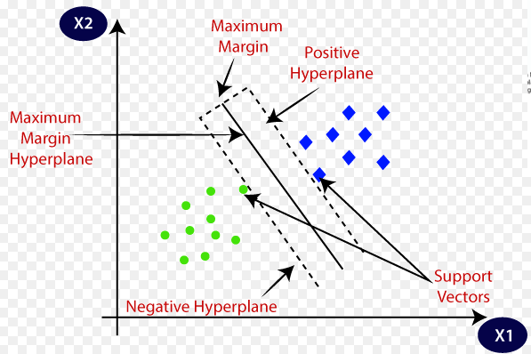
Support Vector Machines
A supervised learning algorithm used for classification and regression tasks.
Hyperplane: The decision boundary that separates different classes in the feature space.
Objective: To find the hyperplane that best separates the classes by maximizing the margin between them.
Margin: The distance between the hyperplane and the closest data points from each class.
Maximum Margin Hyperplane (MMHP): The hyperplane with the largest possible margin.
Positive and Negative Hyperplanes: Parallel hyperplanes on either side of the MMHP, touching the closest data points (support vectors).
Support Vectors: Data points that lie closest to the hyperplane and influence its position and orientation.

Slide 42
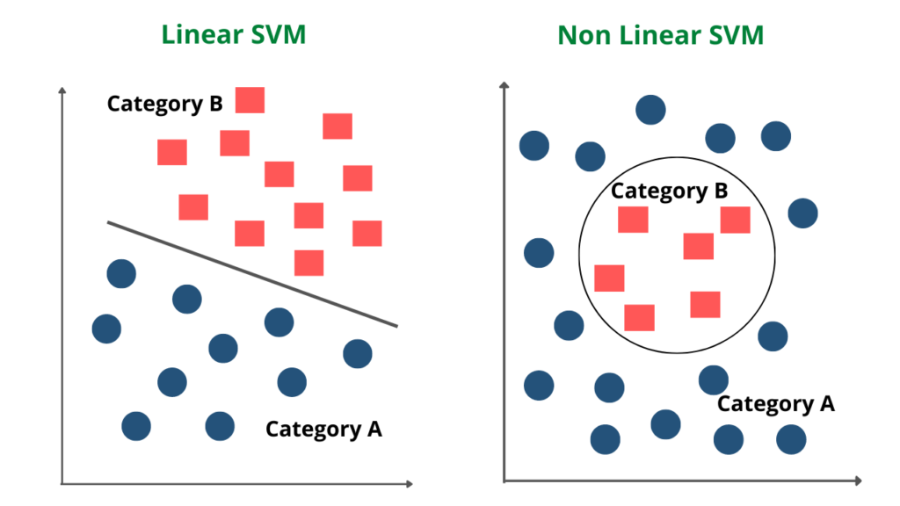
Linear and Non-Linear SVM
Linear SVM: Suitable for linearly separable data where a straight hyperplane can effectively separate the classes.
Non-Linear SVM: Uses kernel functions (e.g., polynomial, radial basis function) to transform data into higher dimensions where a hyperplane can separate the classes.

Slide 43
SVM - Python Implementation
Import Libraries: Import necessary libraries like pandas for data manipulation and scikit-learn for model building.
import pandas as pd
from sklearn.model_selection import train_test_split
from sklearn.svm import SVC
from sklearn.metrics import accuracy_score, classification_report, confusion_matrix
Load Data: Load your dataset using pandas
from sklearn.datasets import load_iris
iris = load_iris()
X = iris.data
y = iris.target
Preprocess Data: Prepare your data by handling missing values, encoding categorical variables, and scaling features if necessary.
For iris dataset, the data is clean

Slide 44
SVM - Python Implementation
Split Data: Split your data into training and testing sets.
X_train, X_test, y_train, y_test = train_test_split(X, y, test_size=0.2, random_state=42)
Train Model: Initialize and train the SVM model using the training data.
svm_model = SVC(kernel='linear’)
svm_model.fit(X_train, y_train)
Make Predictions: Use the trained model to make predictions on the test data.
y_pred = svm_model.predict(X_test)
Evaluate Model: Evaluate the trained model using metrics like accuracy, confusion matrix, and classification report
accuracy = accuracy_score(y_test, y_pred)
report = classification_report(y_test, y_pred)
conf_matrix = confusion_matrix(y_test, y_pred)

Slide 45
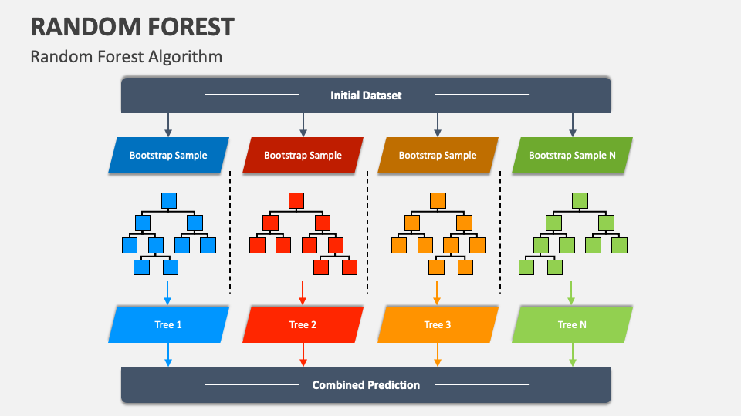
Random Forest
Random Forest is an ensemble learning method that operates by constructing multiple decision trees during training and outputting the mode of the classes for classification or mean prediction for regression.
Bagging: Random Forest uses a technique called bootstrap aggregating (bagging) to create multiple subsets of the original dataset by sampling with replacement.
Decision Trees: For each subset, a decision tree is constructed using a random subset of features. This process helps in reducing overfitting.
Voting/Averaging: In classification, each tree votes for a class, and the class with the majority votes is chosen. In regression, the average of all tree predictions is taken.

Slide 46
Random Forest - Training and Testing Phase
Training Phase:
Bootstrap Sampling: Create multiple subsets of the training data using random sampling with replacement.
Tree Construction: Build a decision tree for each subset, using a random subset of features at each split. This introduces randomness and reduces the correlation between trees.
Testing Phase:
Aggregation: When predicting, each tree in the forest provides a prediction, and these predictions are aggregated (majority vote for classification, mean for regression).
Accuracy Evaluation: The performance is evaluated using metrics such as accuracy, precision, recall, F1-score for classification, and mean squared error for regression.

Slide 47
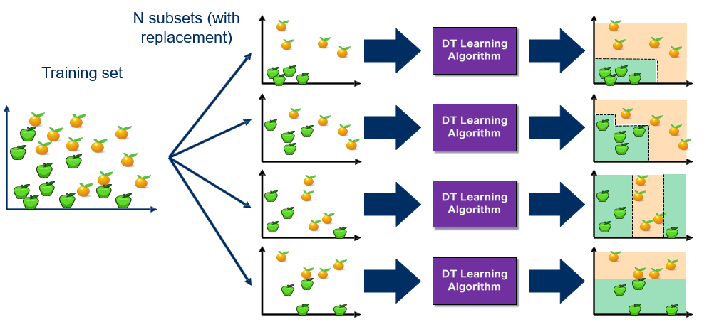
Bagging at Training Time

Slide 48
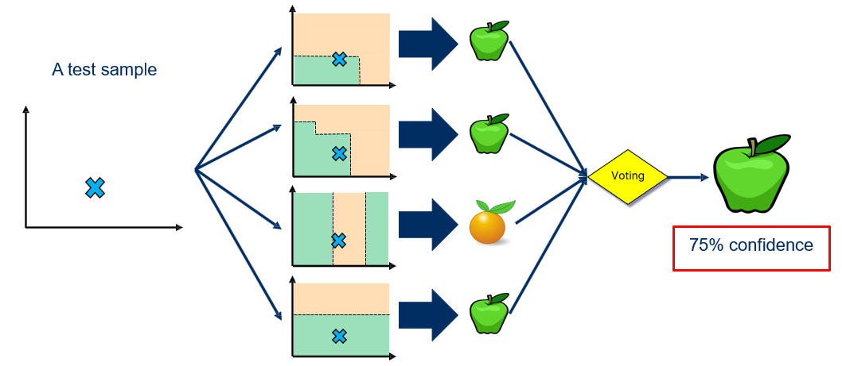
Bagging at Inference Time

Slide 49
Random Forest - Python Implementation
Import Libraries: Import necessary libraries like pandas for data manipulation and scikit-learn for model building.
from sklearn.datasets import load_iris
from sklearn.model_selection import train_test_split
from sklearn.ensemble import RandomForestClassifier
from sklearn.metrics import accuracy_score, classification_report, confusion_matrix
Load Data: Load your dataset using pandas
from sklearn.datasets import load_iris
iris = load_iris()
X = iris.data
y = iris.target
Preprocess Data: Prepare your data by handling missing values, encoding categorical variables, and scaling features if necessary.
For iris dataset, the data is clean

Slide 50
Random Forest - Python Implementation
Split Data: Split your data into training and testing sets.
X_train, X_test, y_train, y_test = train_test_split(X, y, test_size=0.2, random_state=42)
Train Model: Initialize and train the SVM model using the training data.
rf_model = RandomForestClassifier(n_estimators=100, random_state=42)
rf_model.fit(X_train, y_train)
Make Predictions: Use the trained model to make predictions on the test data.
y_pred = rf_model.predict(X_test)
Evaluate Model: Evaluate the trained model using metrics like accuracy, confusion matrix, and classification report
accuracy = accuracy_score(y_test, y_pred)
report = classification_report(y_test, y_pred)
conf_matrix = confusion_matrix(y_test, y_pred)

